Slide 1
Lending Club Case Study
Problem Overview
The data Provided contains information about past loan applicants and whether they ‘defaulted’ or not. The aim is to identify patterns which indicate if a person is likely to default, which may be used for taking actions such as denying the loan, reducing the amount of loan, lending (to risky applicants) at a higher interest rate, etc.

Slide 2
Approach
Data Cleaning.
Outlier Treatment.
Univariate Analysis.
Bi-Variate Analysis.
Identifying driving factors behind loan default, i.e. the variables which are strong indicators of default with correlation matrix.

Slide 3
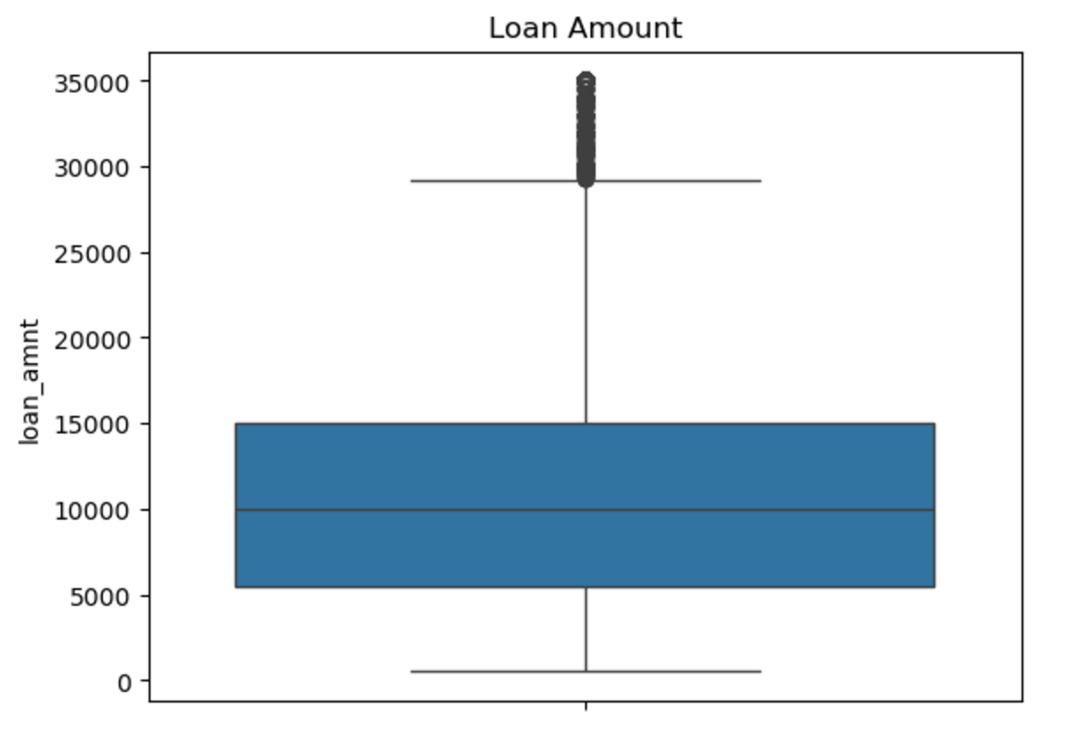
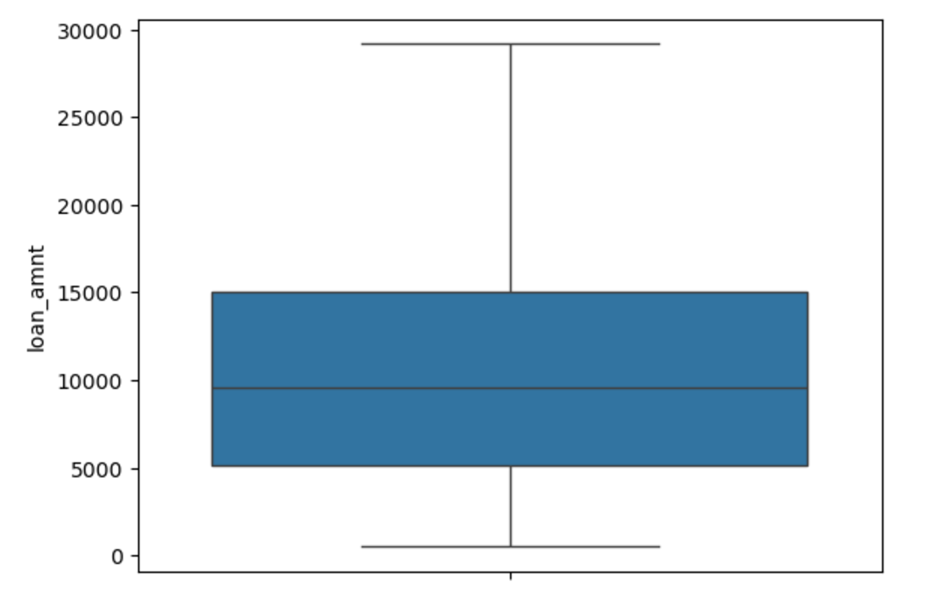
Outlier Treatment – Loan Amount

Slide 4
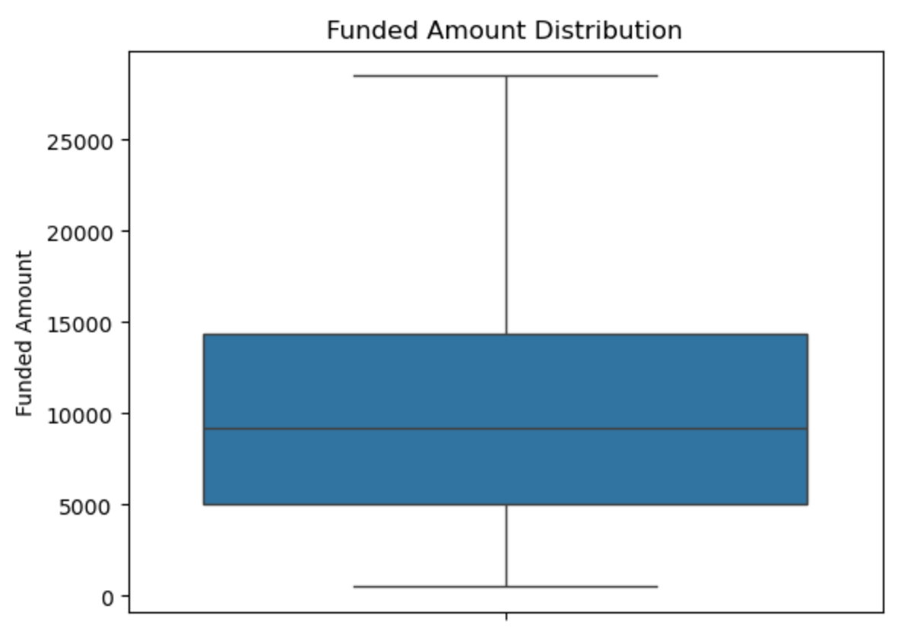
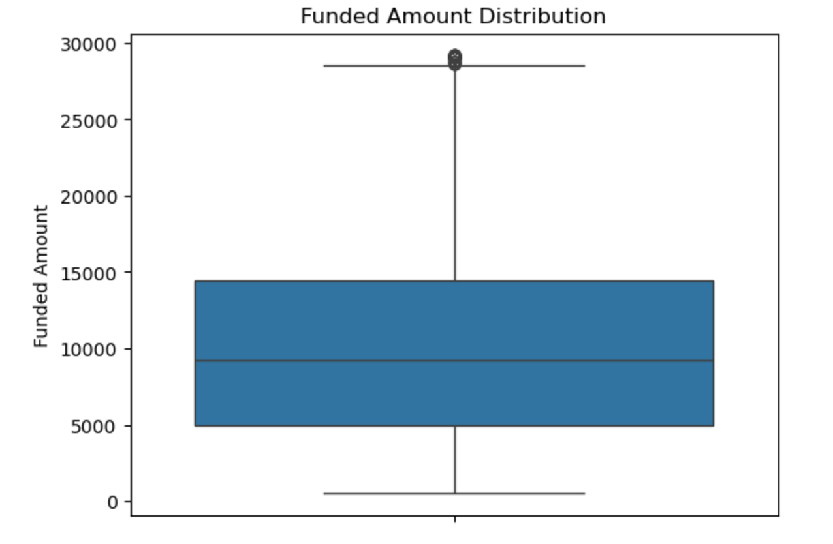
Funded Amount

Slide 5
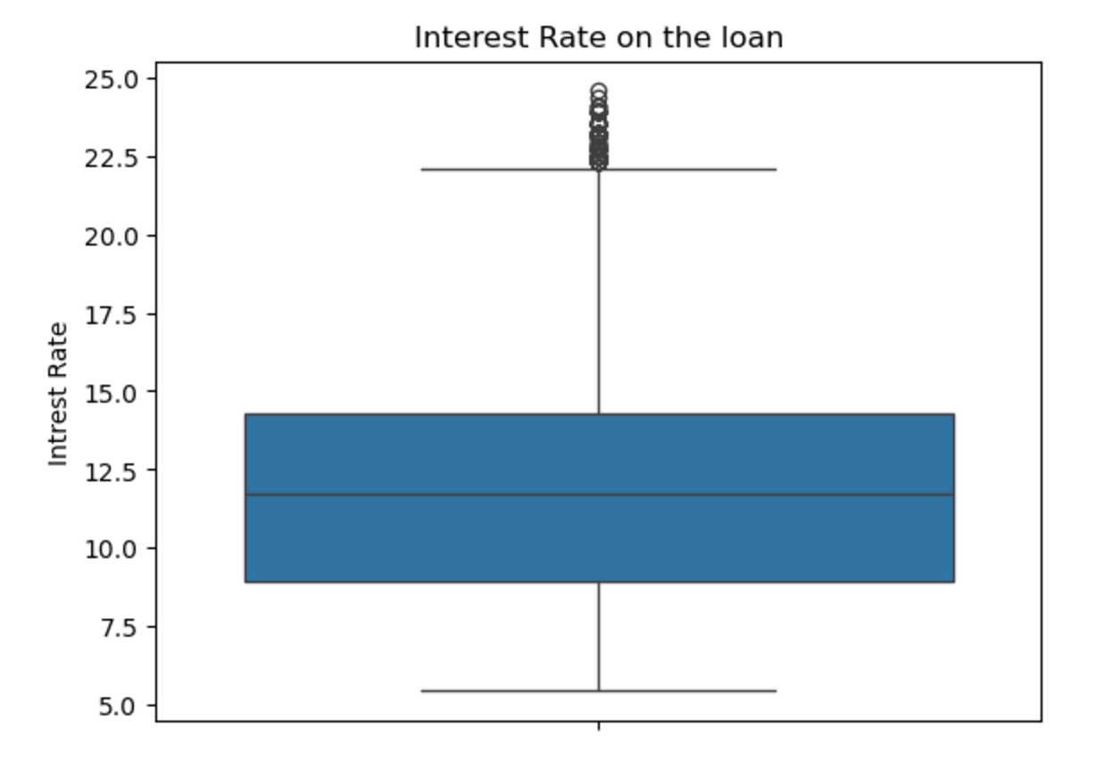
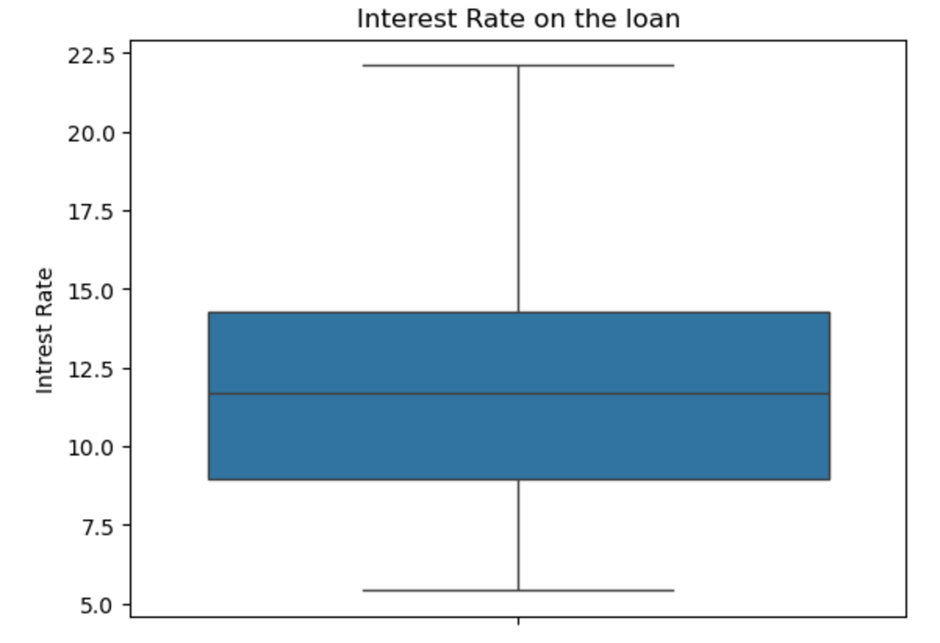
Interest Rate

Slide 6
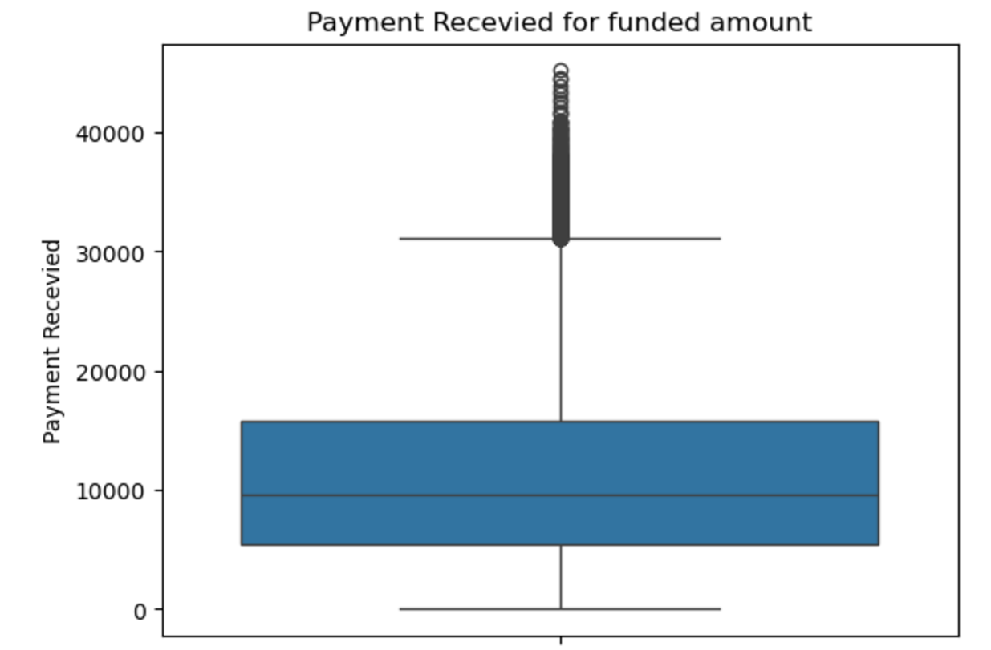
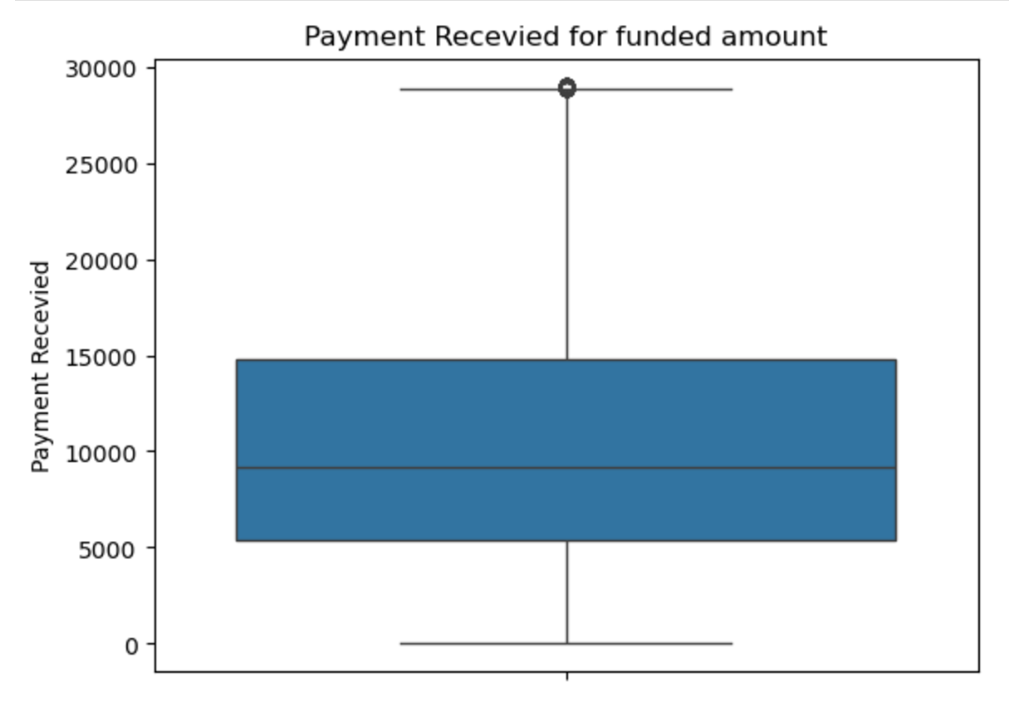
Total Payment : Payments received to date for total amount funded

Slide 7
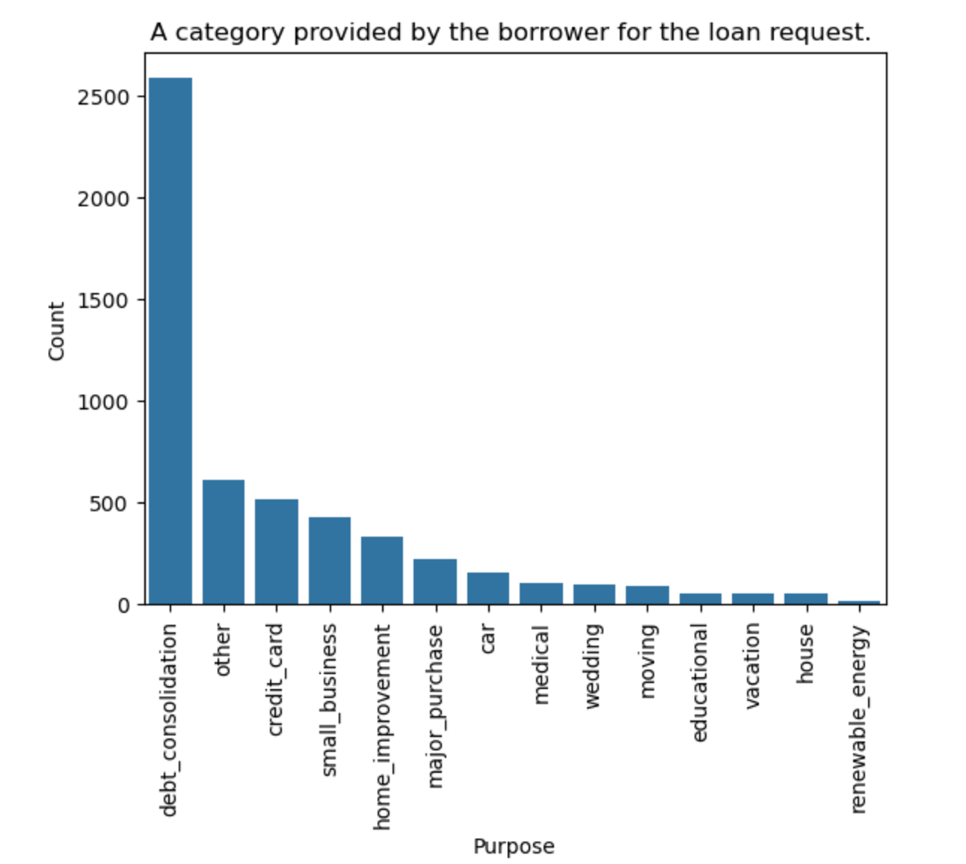
Univariate Analysis
Category provided by the borrower for the loan request.

Slide 8
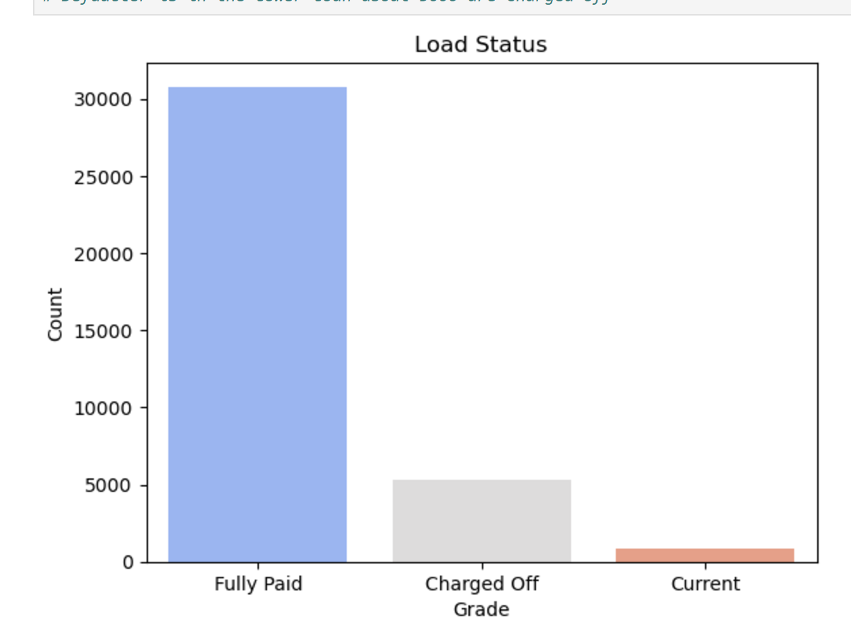
Distribution of Loan Status

Slide 9
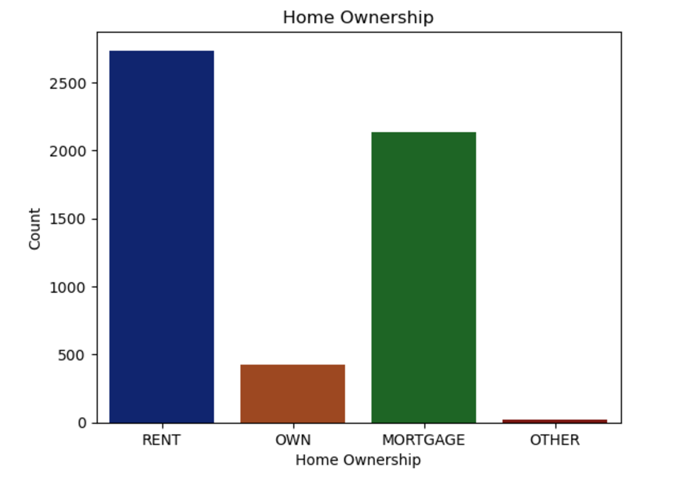
Distribution of Home Ownership

Slide 10
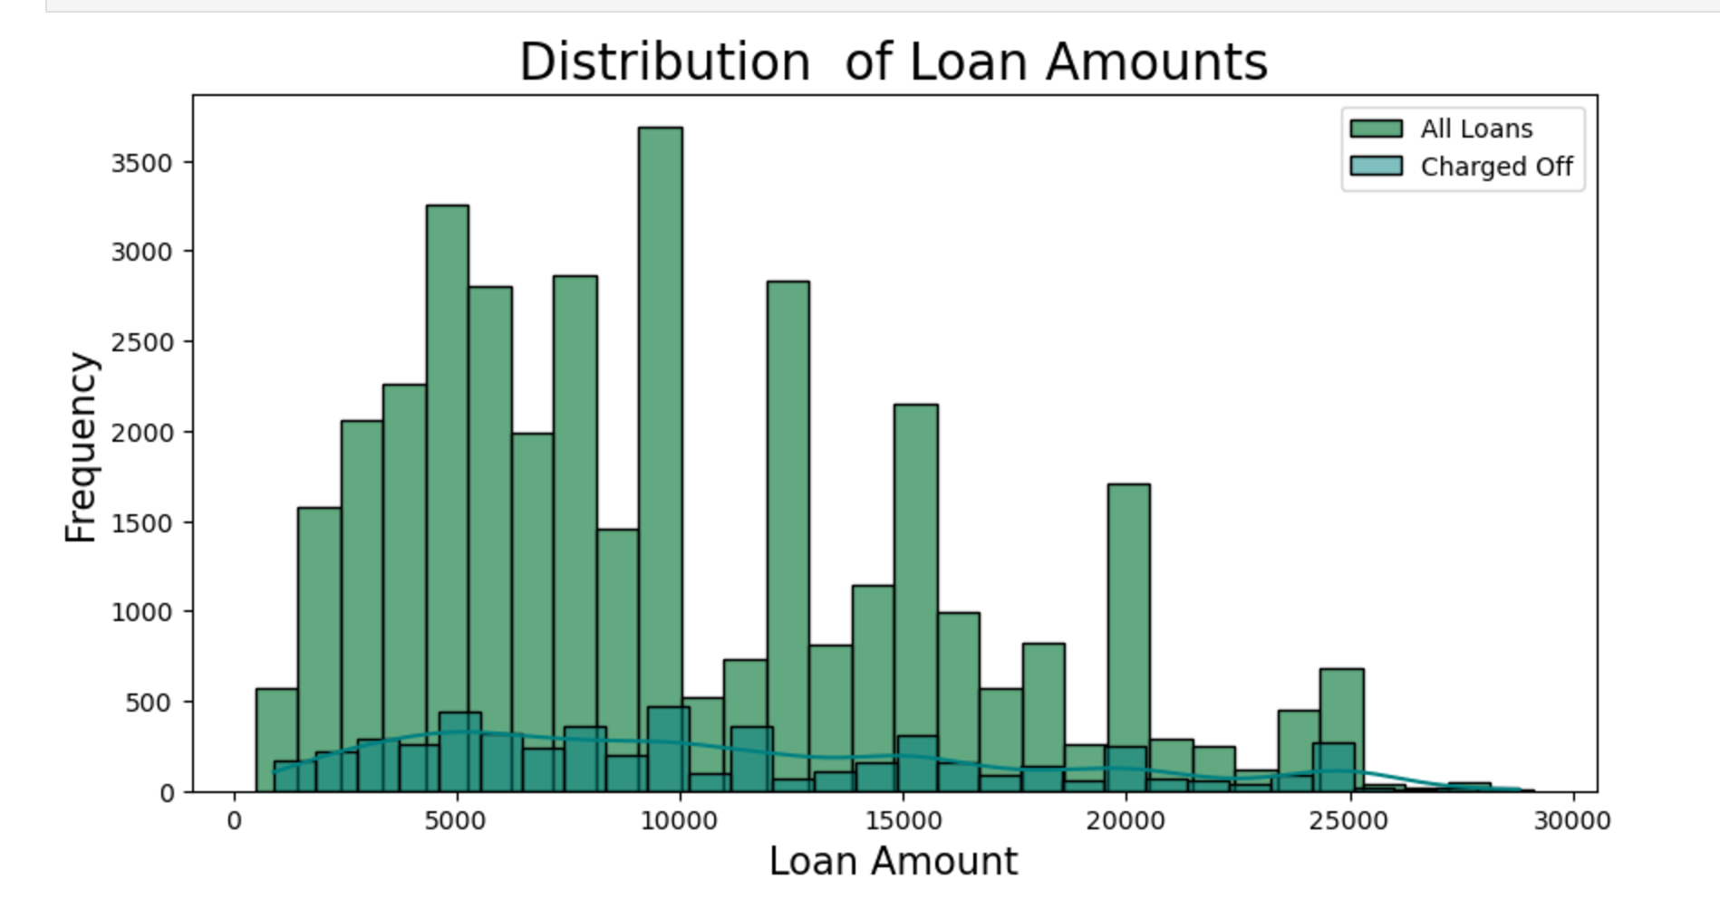
Distribution of Loan Amount

Slide 11
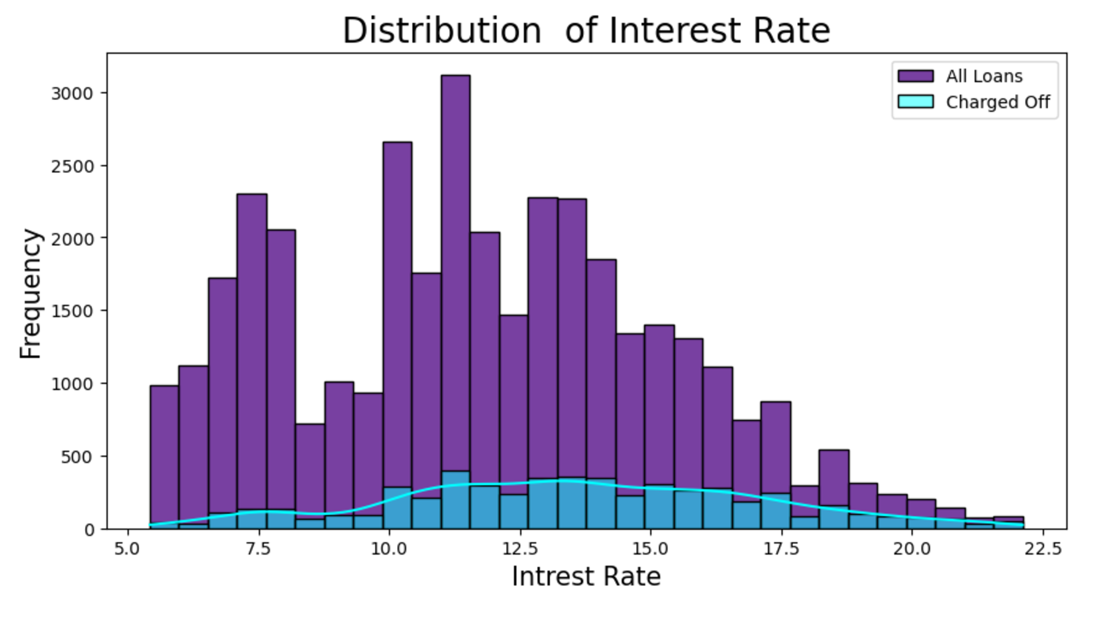
Distribution of Interest Rate

Slide 12
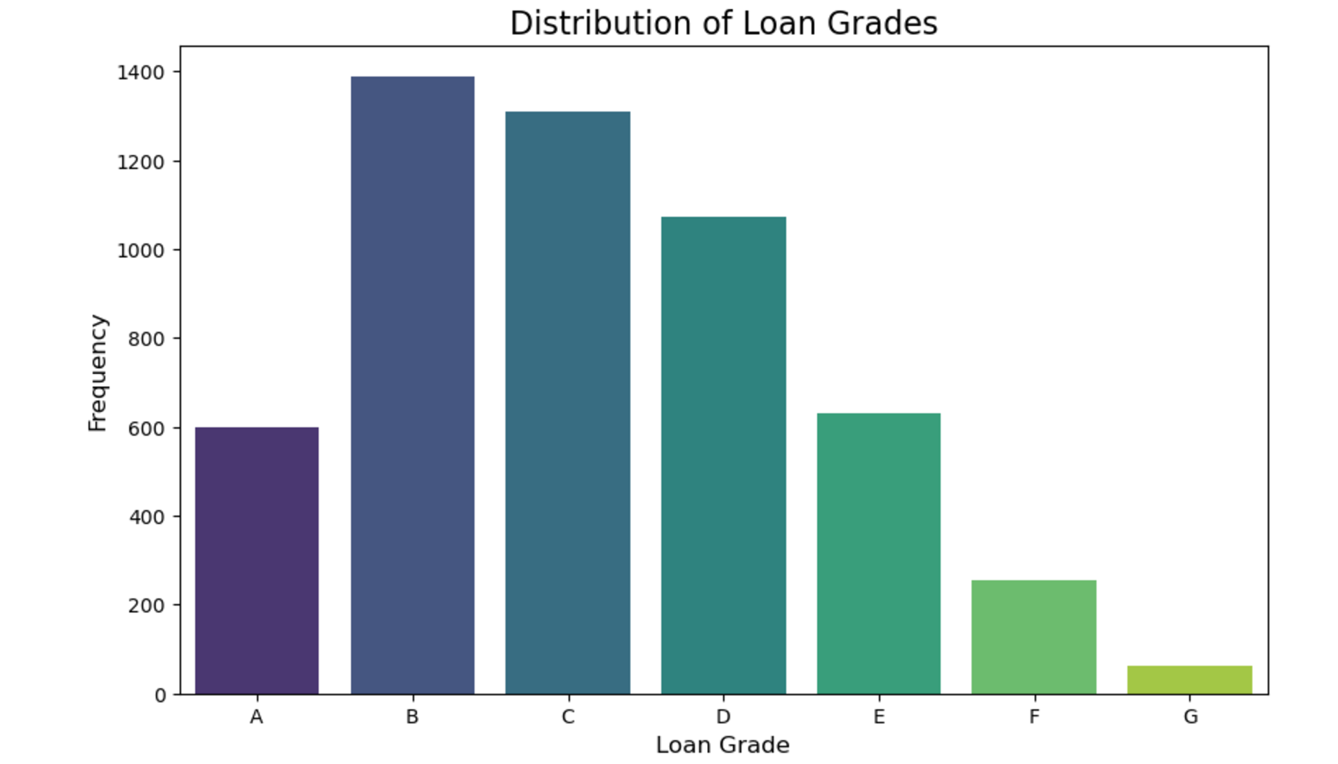
Distribution of Loan Grades

Slide 13
Univariate Analysis Insights
Purpose : dept_consolidation is the maximum case when the customer has charged off
Home ownership : Most of the charged off customers are in 'RENT' and 'MORTGAGE’
Loan marked as 'Charged Off' are in lower to mid range [5000 to 10000] of loan amounts compared to over all distribution
Interest Rate: Defaults are more among the loans with higher interest rates.
Loan grades : Grades B,C, D are common among defaults, Lower grade higher risk of defaults.

Slide 14
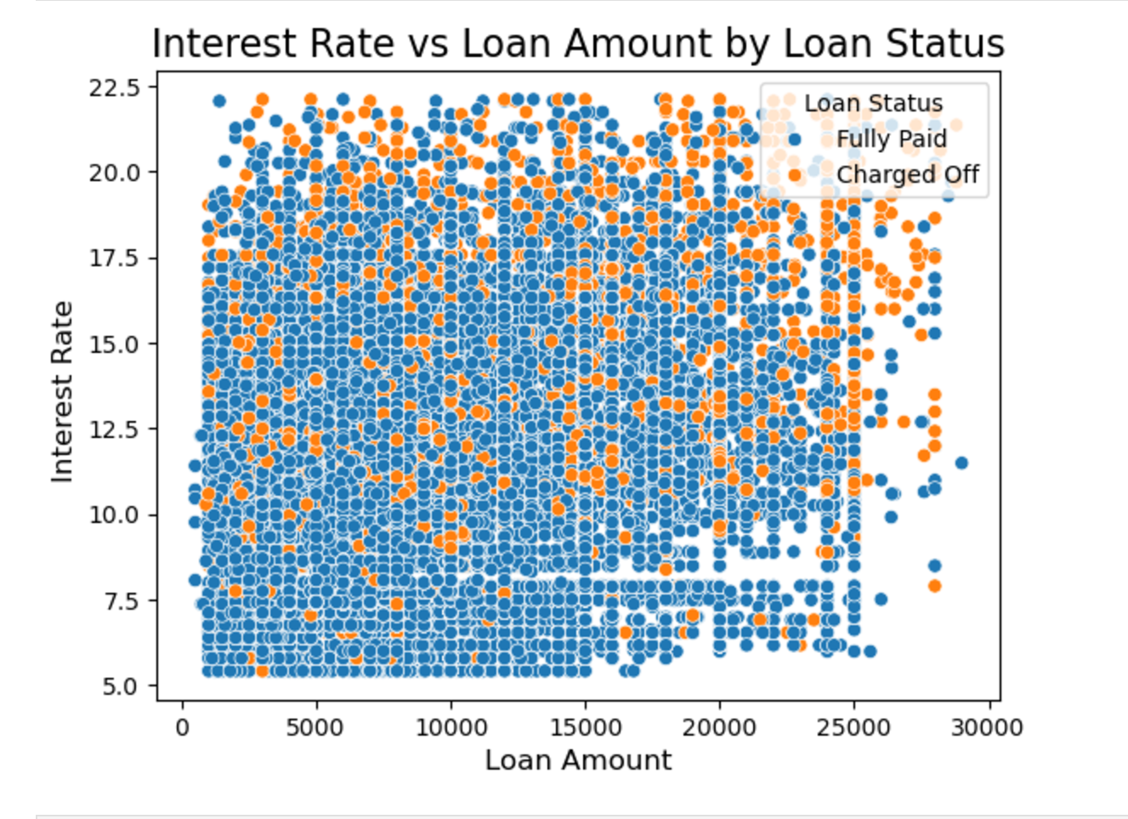
Bivariate Analysis

Slide 15
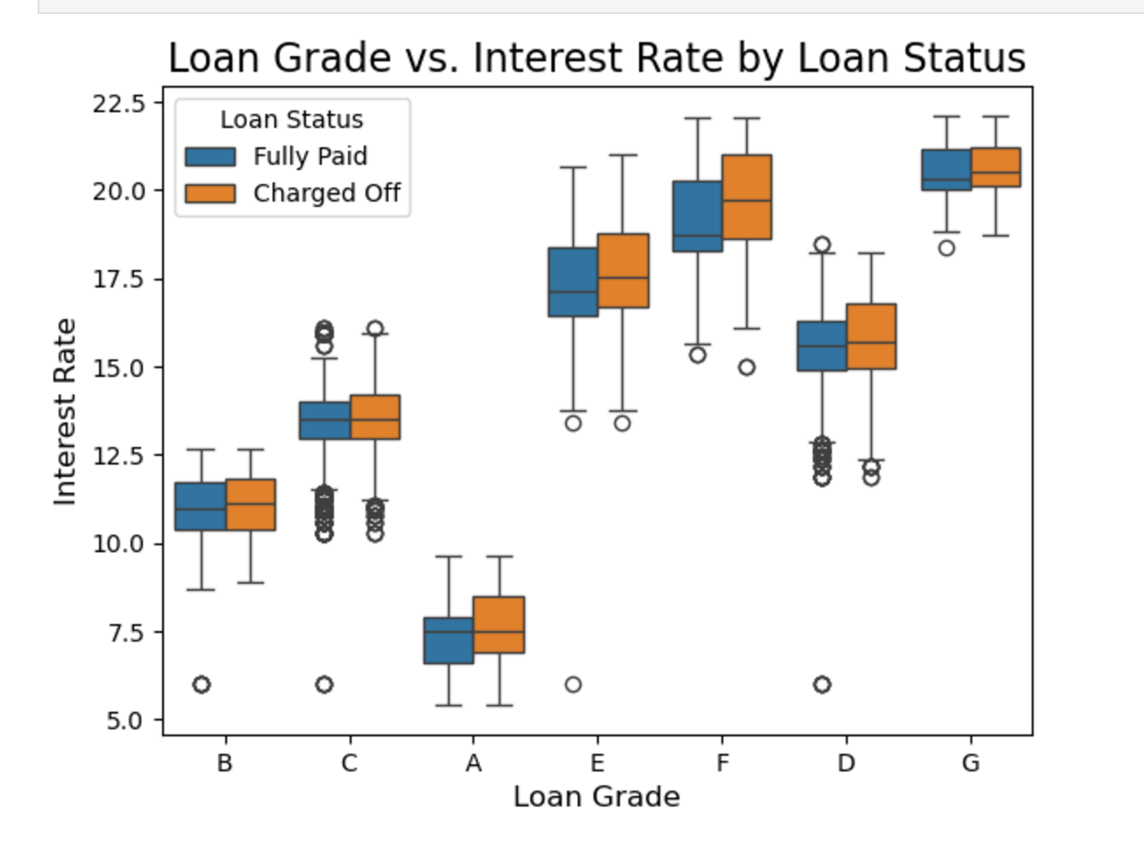
Interest Rate vs Grade

Slide 16
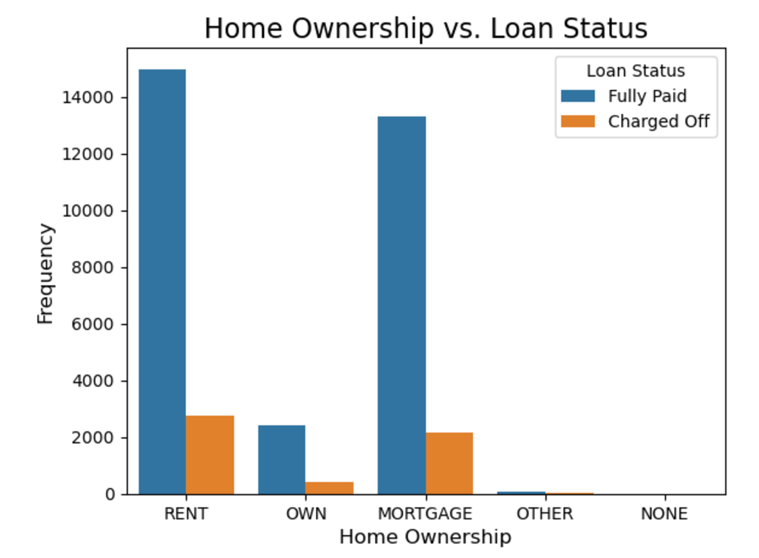
Home Ownership vs Loan status

Slide 17
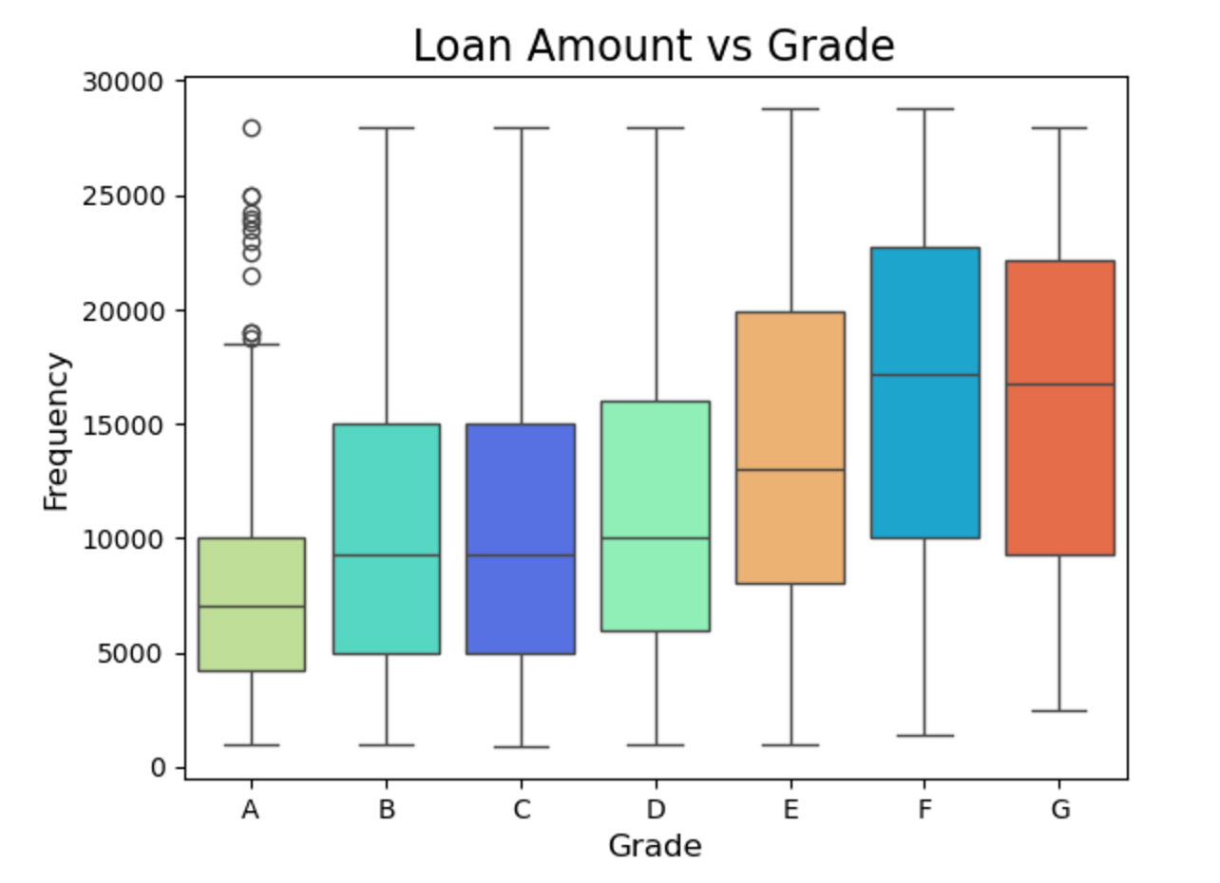
Loan amount vs Grade

Slide 18
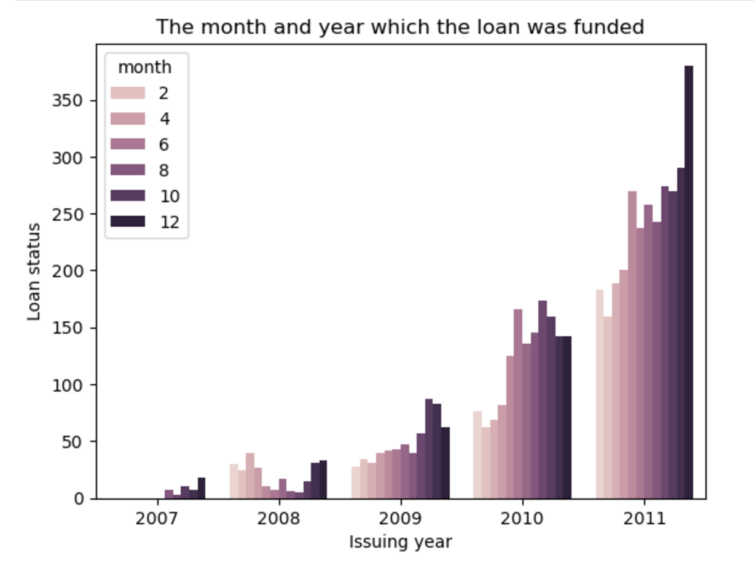
The December 2011 where the loan was funded that were charged off

Slide 19
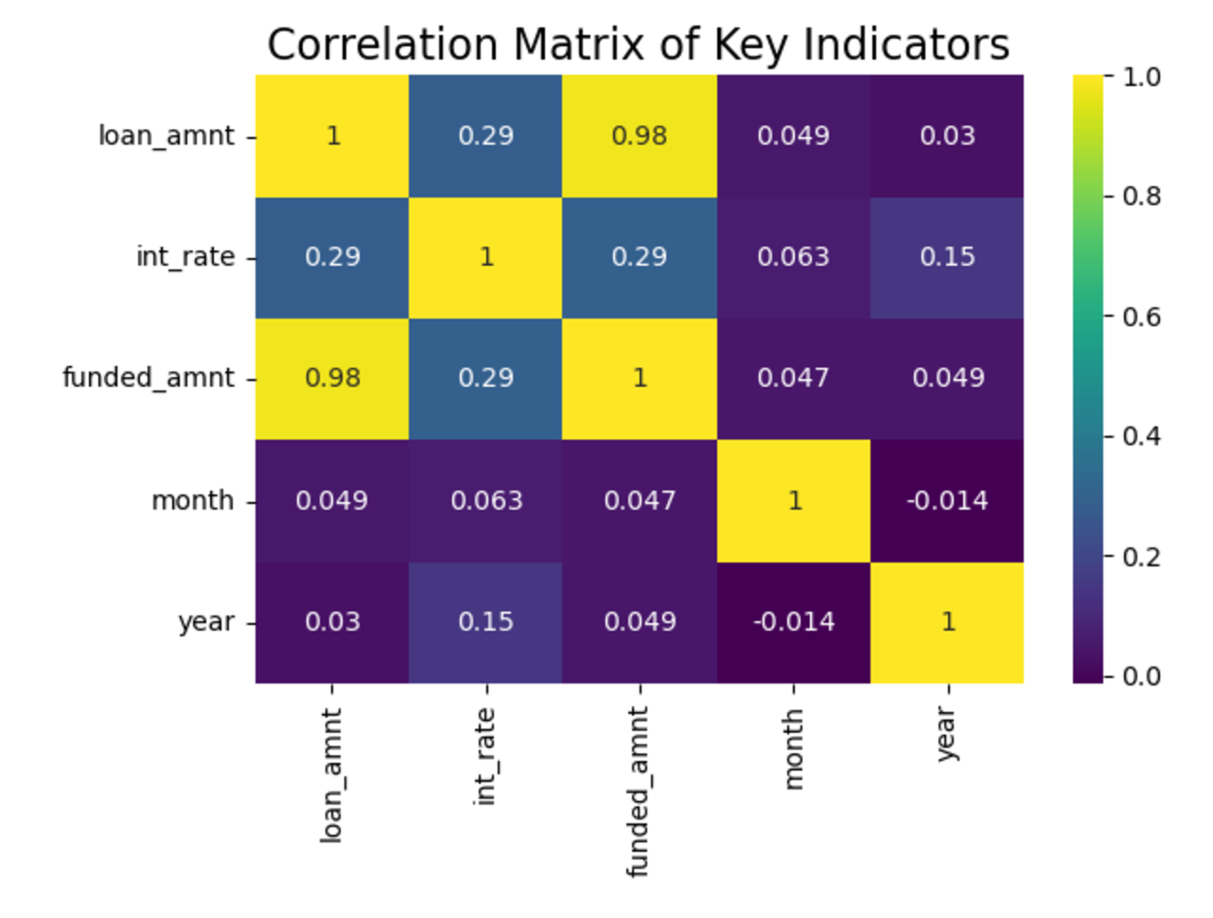
Correlation Matrix of key indicator
Loan Amount
Interest Rate
Funded Amount
Issued ID (Year and Month)

Slide 20
Bivariate Analysis insights
Interest Rate vs Loan status : Loan with higher interest rate > 12 % are more likely to Charge off.
Interest Rate vs Grade : Loan with grade D, E , F with higher interest rate are more likely to charge off.
Home Ownership vs Loan status : Applicants with home rent and mortgage are charged off
Loan amount vs Grade: Grade 'E,F,G' corresponds to larger loan amount are charged off
Issue ID : The December 2011 where the loan was funded that were charged off

